Slide 1
http://www.vidyanidhi.com/
ketkiacharya.net@gmail.com
Ketki Acharya
From: SM VITA ATC of CDAC
9769201036
ketkiacharya.net@gmail.com

Slide 2
Mongoose/ ODM
Mongoose is an Object Data Modeling (ODM) library for MongoDB and Node. js. It manages relationships between data, provides schema validation, and is used to translate between objects in code and the representation of those objects in MongoDB.
Mongoose is a JavaScript library that allows you to define schemas with strongly typed data. Once a schema is defined, Mongoose lets you create a Model based on a specific schema. A Mongoose Model is then mapped to a MongoDB Document via the Model's schema definition

Slide 3
Mongoose models provide several static helper functions for CRUD operations. Each of these functions returns a mongoose Query object.
Model.deleteMany({ age: { $lt: 18 } }) → Deletes all documents matching the filter.
Model.deleteOne({ username: 'sriram' }) → Deletes the first document matching the filter.
Model.find({ active: true }) → Retrieves all documents matching the filter as an array. Model.findById('605c72ef2f1b2c001f6478a9') → Finds a single document by its _id. Model.findByIdAndDelete('605c72ef2f1b2c001f6478a9') → Finds a document by _id and deletes it. Model.findByIdAndUpdate('605c72ef2f1b2c001f6478a9', { age: 30 }) → Finds a document by _id and updates it. Model.findOne({ email: 'abc@example.com' }) → Finds the first document matching the filter. Model.findOneAndDelete({ username: 'guest' }) → Finds one document matching the filter and deletes it. Model.findOneAndReplace({ username: 'guest' }, { username: 'newUser', age: 25 }) → Finds one document matching the filter and replaces it entirely.
Model.findOneAndUpdate({ email: 'abc@example.com' }, { active: false }) → Finds one document matching the filter and updates it.
Model.replaceOne({ username: 'oldUser' }, { username: 'newUser', age: 25 }) → Replaces the first document matching the filter with a new one.
Model.updateMany({ active: false }, { active: true }) → Updates all documents matching the filter.
Model.updateOne({ username: 'sriram' }, { age: 35 }) → Updates the first document matching the filter.

Slide 4
To start things off, let’s go ahead and create a fresh Node.js project with the appropriate dependencies. From the command line, execute the following:
npm init
npm install express body-parser mongoose --save npm i --save cors
The above commands will create a new package.json file and install Express.js, Mongoose, and a package that will allow us to pass JSON data around in our requests.
For simplicity, we’re going to keep all of our code within a single JavaScript file. Create an app.js file at the root of your project and include the following boilerplate code:
app.listen(8081, () => { console.log("Listening at :8081..."); });
In the above code we are doing a few things.
First we are importing each of the dependencies that we had previously downloaded when creating our project.
Next we are initializing Express Framework and configuring the body-parser package so we can receive JSON data in our payloads.
The API we develop will be create, retrieve, update, and delete (CRUD) oriented hence the five endpoint functions that are prepared. We’ll be adding the MongoDB and Mongoose logic to each of these endpoint functions.
Finally, we are listening for requests to our application on port 3000.

Slide 5
const Express = require("express");
const Mongoose = require("mongoose");
const cors = require('cors');
const app = Express();
// Connect to MongoDB with recommended options
mongoose.connect("mongodb://127.0.0.1:27017/mydb")
.then(() => console.log(" Connected to MongoDB"))
.catch(err => console.error(" MongoDB connection error:", err));
// Define schema with validation
const personSchema = new mongoose.Schema({
firstname: { type: String, required: true },
lastname: { type: String, required: true }
});
// Create model (collection will be `customers`)
const PersonModel = mongoose.model("customer", personSchema);
var corsOptions = {
origin: '*',
optionsSuccessStatus: 200, // For legacy browser support
methods: "GET, PUT, DELETE, POST"
}
app.use(cors(corsOptions));
app.use(Express.json());
app.get("/person", async (request, response) => {
try {
const result = await PersonModel.find().exec();
response.json(result);
} catch (error) {
response.status(500).send(error);
}
});
app.post("/person", async (request, response) => {
try { const person = new PersonModel(request.body);
const result = await person.save();
response.json(result);
} catch (error) {
response.status(500).send(error);
}
});
Complete Demo

Slide 6
app.get("/person/:id", async (request, response) => {
try {
const person = await PersonModel.findById(request.params.id).exec();
response.json(person);
}
catch (error) {
response.status(500).json(error);
}
});
app.put("/person/:id", async (request, response) => {
try {
const person = await PersonModel.findById(request.params.id).exec();
person.set(request.body);
const result = await person.save();
response.send(result);
}
catch (error) {
response.status(500).json(error); }
});
app.delete("/person/:id", async (request, response) => {
try {
const result = await PersonModel.deleteOne({ _id: request.params.id }).exec();
response.json(result);
}
catch (error) { response.status(500).json(error); }
});
app.listen(8081, () => { console.log("Listening at :8081..."); });

Slide 7
// Loads the Express framework into your project
const express = require("express");
//Loads the Mongoose library, which is an Object Data Modeling (ODM) tool for MongoDB.
const mongoose = require("mongoose");
//Creates an Express application instance.
const app = express();
// Connect to MongoDB with recommended options
mongoose.connect("mongodb://127.0.0.1:27017/mydb")
.then(() => console.log(" Connected to MongoDB"))
.catch(err => console.error(" MongoDB connection error:", err));
Connects to a MongoDB database named mydb running locally on port 27017.

Slide 8
// Middleware
- Adds middleware to parse incoming JSON request bodies.
Without this, req.body would be undefined when you send JSON data in POST/PUT requests.
app.use(express.json());
→ This creates a blueprint (schema) for documents in a MongoDB collection.
:
firstname → The field must be a string.
→ This field is mandatory;
MongoDB will reject documents without it.
Together, this schema enforces validation rules so every document must have both and as strings.
// Define schema with validation
const personSchema = new mongoose.Schema({
firstname: { type: String, required: true },
lastname: { type: String, required: true }
});
// Create model (collection will be `customers`)
const PersonModel = mongoose.model("customer", personSchema);
- mongoose.model() → Converts the schema into a Model.
- Parameters:
- "customer" → The model name. Mongoose automatically pluralizes this to create the collection name.
- So "customer" → customers collection in MongoDB.
- personSchema → The schema you defined earlier.
- PersonModel → This is the actual JavaScript class you’ll use to interact with the customers collection.

Slide 9
app.get("/person", async (req, res, next) => {
try {
const result = await PersonModel.find().exec();
res.json(result);
} catch (error) {
next(error);
}
});
- Sends the query result back to the client as a JSON response.
- PersonModel.find() → Queries the customers collection (remember, your model was customer) for all documents.
- .exec() → Executes the query and returns a real Promise.
- await → Pauses execution until the query finishes.
- result → Will contain an array of person objects from MongoDB.

Slide 10
app.get("/person/:id", async (req, res, next) => {
try {
const person = await PersonModel.findById(req.params.id).exec();
if (!person)
return res.status(404).send("Person not found");
res.json(person);
} catch (error) {
next(error);
}
});
→ Queries the collection for a document with the given .
→ Extracts the ID from the URL.
→ Executes the query and returns a real Promise.
→ Waits until the query finishes.
→ Will be either the found document or if no match exists.

Slide 11
// PUT update person by ID
app.put("/person/:id", async (req, res, next) => {
try {
const person = await PersonModel.findById(req.params.id).exec();
if (!person)
return res.status(404).send("Person not found");
person.set(req.body);
const result = await person.save();
res.json(result);
} catch (error) {
next(error);
}
});
PersonModel.findById() → Searches the customers collection for a document with the given _id.
req.params.id → Extracts the ID from the URL.
.exec() → Executes the query and returns a real Promise.
await → Waits until the query finishes.
- person → Will be either the found document or null if no match exists.

Slide 12
// POST new person
app.post("/person", async (req, res, next) => {
try {
const person = new PersonModel(req.body);
const result = await person.save();
res.status(201).json(result);
} catch (error) {
next(error);
}
});
- Sends a 201 Created status code (best practice for successful POST that creates a resource).
- Responds with the saved document as JSON
Creates a new Mongoose document using the . new PersonModel(req.body);
• req.body contains the JSON data sent by the client.
• Example: If the client sends , {“firstname” : ”vita”,”lastname” : ”vidya”}
this line builds a new document with those values.
• Validation rules from the schema ( and required) are applied here.
- const result = await person.save();
Saves the new document into the customers collection in MongoDB.
- await ensures the save completes before moving on.
- result contains the saved document, including MongoDB-generated fields like _id

Slide 13
// DELETE person by ID
app.delete("/person/:id", async (req, res, next) => {
try {
const result = await PersonModel.deleteOne({ _id: req.params.id }).exec();
if (result.deletedCount === 0) {
return res.status(404).send("Person not found");
}
res.send("Person deleted successfully");
} catch (error) {
next(error);
}
});
- PersonModel.deleteOne() → Attempts to delete a single document from the customers collection where _id matches req.params.id.
- .exec() → Executes the query and returns a Promise.
- await → Waits until the deletion completes.
result → Contains metadata about the deletion, not the document itself. Example
{ "acknowledged": true, "deletedCount": 1 }
- Checks if no document was deleted (deletedCount === 0).
- If true, sends a 404 Not Found response with "Person not found".
- The return ensures the function stops here.
res.send("Person deleted successfully");
-

Slide 14
// ------------------- ERROR HANDLER -------------------
app.use((err, req, res, next) => {
console.error(err.stack);
res.status(500).send({err:"Something went wrong!"});
});
Error-handling middleware always takes four arguments.
You must provide four arguments to identify it as an error-handling middleware function. Even if you don’t need to use the next object, you must specify it to maintain the signature. Otherwise, the next object will be interpreted as regular middleware and will fail to handle errors.

Slide 15
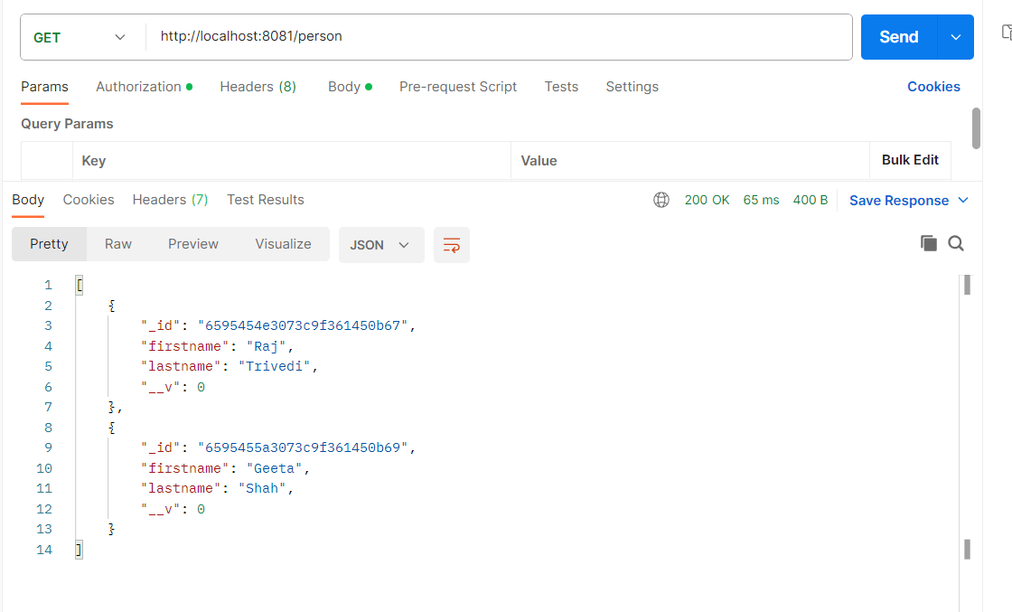

Slide 16
Interacting with MongoDB using the Mongoose ODM
With the foundation of our REST API in place, we can focus on the database logic. Within the project’s app.js file include the following near where you initialized Express Framework:
Mongoose.connect("mongodb://localhost:27017/empdb");
The above line will connect to our MongoDB instance running on localhost and it will either use or create a empdb database.
Mongoose.connect("mongodb://127.0.0.1:27017/mydb");

Slide 17
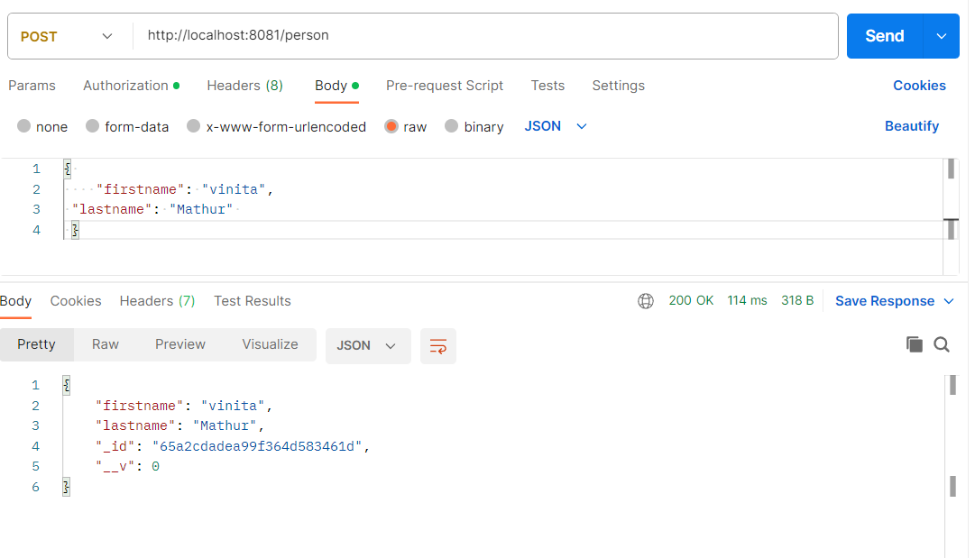

Slide 18
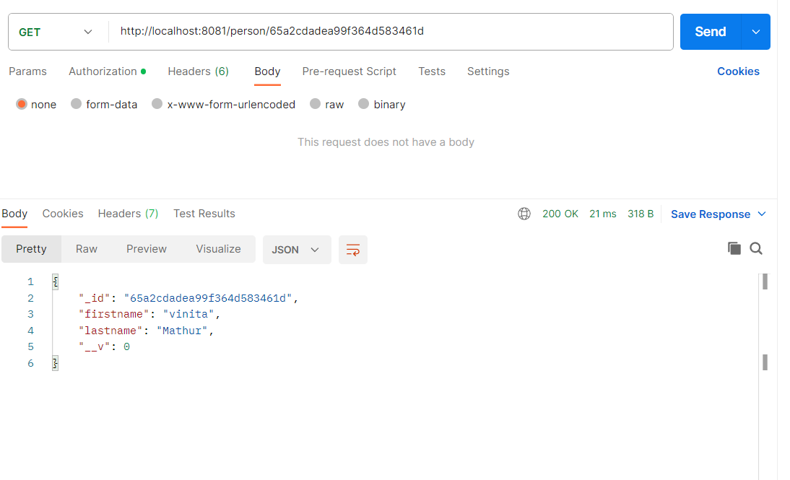

Slide 19
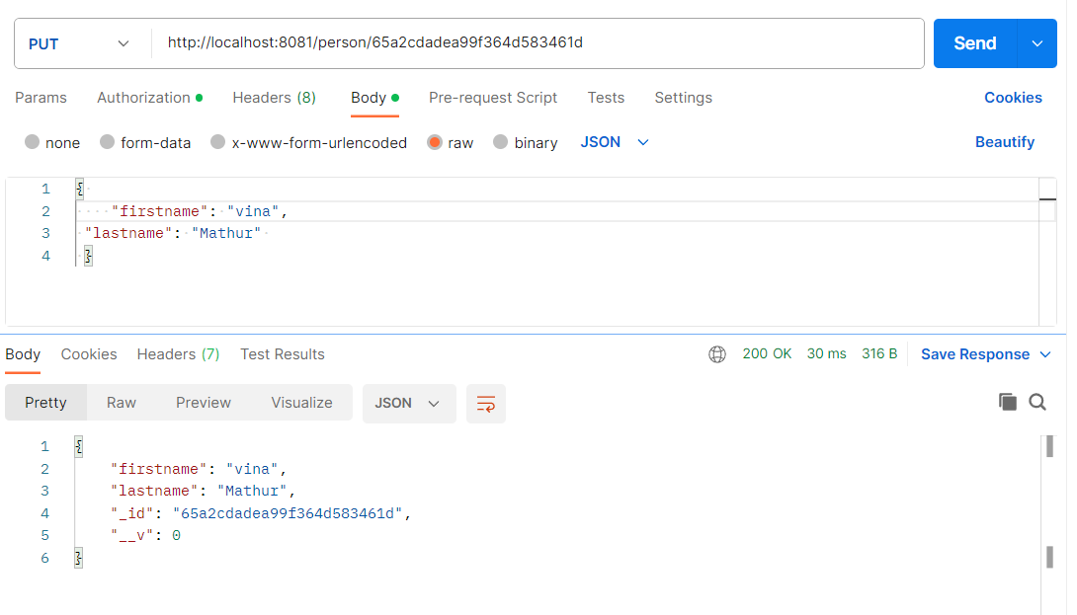

Slide 20
